Slide 1
Web Services

Slide 2
Web Service
A system resides on a web server for serving client specific needs
Can perform calculations, serve specific utilities, but mainly used to expose data to clients
There are many techniques, architectures and technologies to create Web Service:
XML Web Services
Remote Procedure Calls
Windows Communication Foundation
REST APIs
and more…

Slide 3
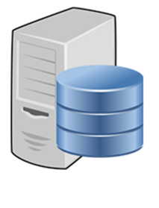



Web Service Example
End-user browser:
Surfs to the Weather Station’s website
Weather Station:
Exposes weather data through a website

Slide 4
Web Service Example
End-user browser:
Surfs to the Weather Station’s website
Weather Station’s website:
Consumes the Weather Station’s Web Service
Weather Station:
Exposes weather data through Web Service

Slide 5
Web Service Example
End-user browser:
Surfs to a weather page on the news portal website
News portal website:
Consumes the Weather Station’s Web Service
Weather Station:
Exposes weather data through Web Service

Slide 6

Web Service Example
Weather mobile app:
Consumes the Weather Station’s Web Service
Weather Station:
Exposes weather data through Web Service

Slide 7

Web Service Example
Weather statistics consumers:
Consumes the weather statistics’ Web Service
Weather statistics Web Service:
Consumes the Weather Station’s Web Service for its own consumers
Weather Station:
Exposes weather data through Web Service

